Slide 1


Nico Kruber nico@data-artisans.com
June 11, 2018
What’s new in Stateful Stream Processing with Apache Flink 1.5 and beyond

Slide 2




dA Platform
Open Source Apache Flink + dA Application Manager
Original creators of
Apache Flink®

Slide 3
Agenda for today
What is Apache Flink?
Flink 1.5 changes
  Deployment and Process Model
  Broadcast State
  Network Stack
  Task-Local Recovery
  SQL
What’s next? - Flink 1.6 and beyond
Q&A

Slide 4
What is Apache Flink?

Slide 5


Apache Flink in a Nutshell
Stateful computations over streams
real-time and historic
fast, scalable, fault tolerant, in-memory,
event time, large state, exactly-once
Queries
Application
Applications
Streams
Database
Devices
Stream
etc.
Historic
Data
File / Object
Storage

Slide 6
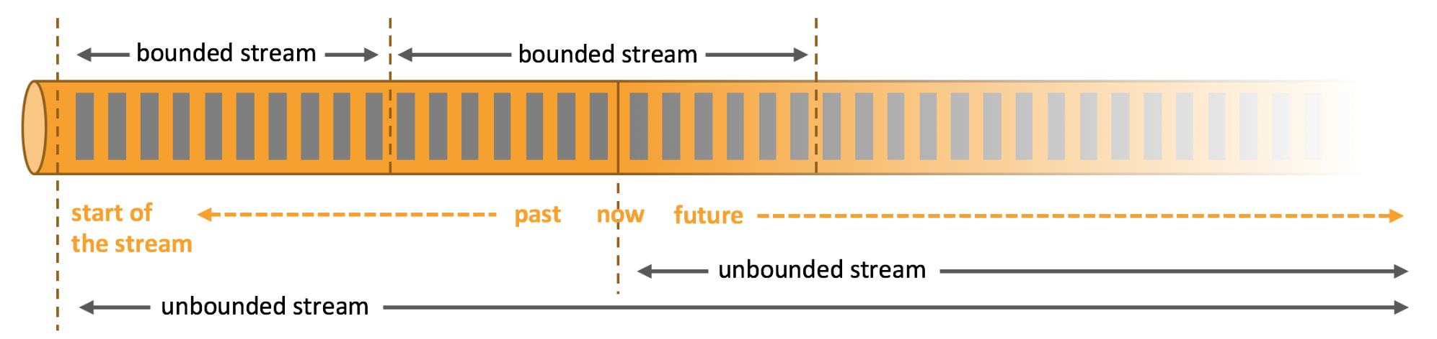
Everything Streams
Apache Flink handles everything as streams internally.
Continuous streaming and applications use "unbounded streams".
Batch processing and finite applications use "bounded streams".

Slide 7

Layered abstractions
Navigate simple to complex use cases
High-level
Analytics API
Stream SQL / Tables (dynamic tables)
val stats = stream
.keyBy("sensor")
.timeWindow(Time.seconds(5))
.sum((a, b) -> a.add(b))
Stream- & Batch Data Processing
DataStream API (streams, windows)
Stateful Event-
Driven Applications
Process Function (events, state, time)
def processElement(event: MyEvent, ctx: Context, out: Collector[Result]) = {
// work with event and state
(event, state.value) match { … }
out.collect(…) // emit events
state.update(…) // modify state
// schedule a timer callback
ctx.timerService.registerEventTimeTimer(event.timestamp + 500)
}

Slide 8
DataStream API
val lines: DataStream[String] = env.addSource(new FlinkKafkaConsumer011(…))
val events: DataStream[Event] = lines.map((line) => parse(line))
val stats: DataStream[Statistic] = stream
.keyBy("sensor")
.timeWindow(Time.seconds(5))
.sum(new MyAggregationFunction())
stats.addSink(new RollingSink(path))
Source
Transformation
Windowed Transformation
Sink
Streaming
Dataflow
Source
Transform
Window
(state read/write)
Sink

Slide 9
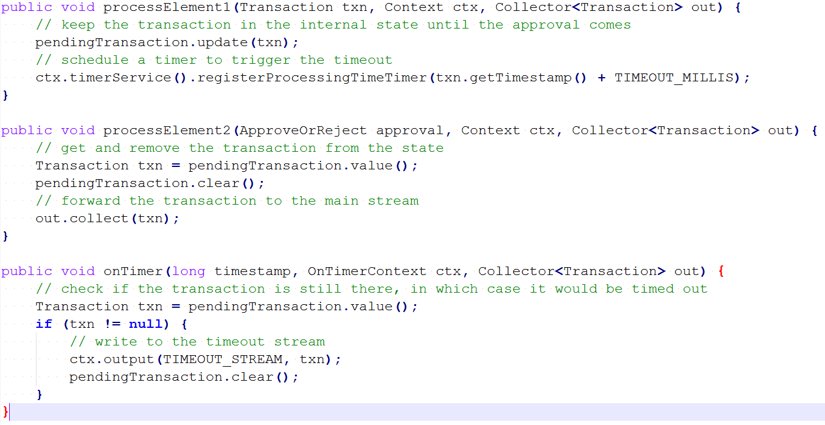
Low Level: (Co)Process Function

Slide 10
High Level: SQL (ANSI)
SELECT
campaign,
TUMBLE_START(clickTime, INTERVAL ’1’ HOUR),
COUNT(ip) AS clickCnt
FROM adClicks
WHERE clickTime > ‘2017-01-01’
GROUP BY campaign, TUMBLE(clickTime, INTERVAL ‘1’ HOUR)
Query
start of
the stream
past
now
future

Slide 11
How Large (or Small) can Flink get?

Slide 12
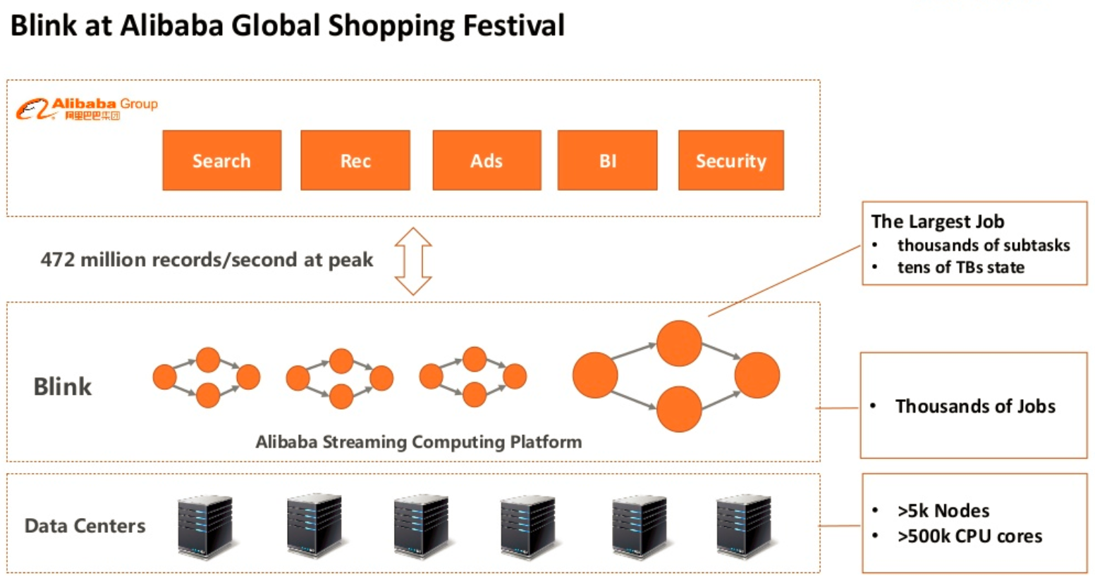
Blink is Alibaba's
Flink-based System

Slide 13
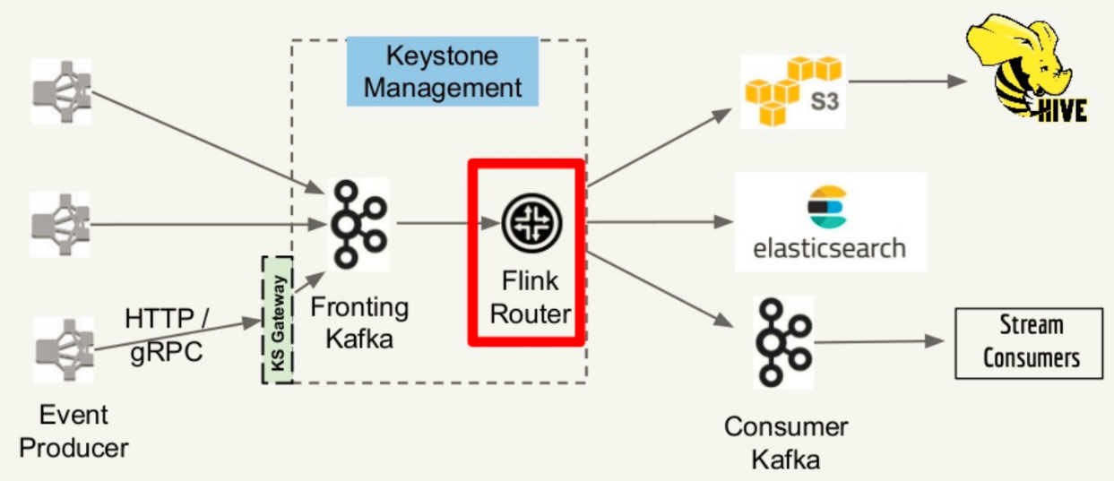
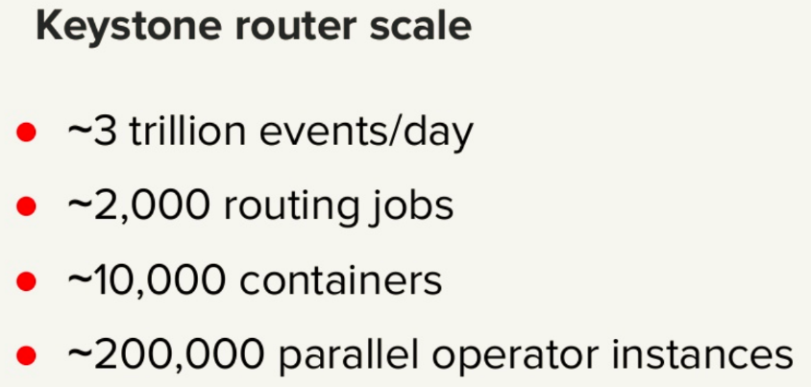
Keystone Routing Pipeline at Netflix
(as presented at Flink Forward San Francisco, 2018)

Slide 14
Small Flink
Can run in single process
Some users run it on IoT Gateways
Also runs with zero dependencies in IDE

Slide 15
Flink 1.5

Slide 16
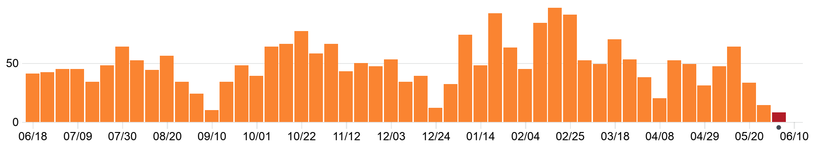
Flink 1.5 in numbers
5 months of work
106 contributors
>1500 commits
>780 JIRA issues resolved
+225,274 / - 71,170 LOC
http://flink.apache.org/news/2018/05/25/release-1.5.0.html

Slide 17
Deployment and Process Model

Slide 18




1001 Deployment Scenarios
Many different deployment scenarios
  Yarn
  Mesos
  Docker/Kubernetes
  Standalone
  Etc.

Slide 19
Different Usage Patterns
Few long running vs. many short running jobs
  Overhead of starting a Flink cluster
Job isolation vs. sharing resources
  Allowing to define per job credentials & secrets
  Efficient resource utilization by sharing them

Slide 20
Job & Session Mode
Session mode
  Shared cluster for multiple jobs
  Resources can be shared across jobs
  Cluster deployment and job submission separate actions
Job mode
  Dedicated cluster for a single job
  Job should be part of the cluster deployment

Slide 21



Flink Improvement Proposal 6
Introduce generic building blocks
Compose blocks for different scenarios
Effort started by:
Flip-6 design document: https://cwiki.apache.org/confluence/pages/viewpage.action?pageId=65147077

Slide 22
The Building Blocks
ResourceManager
Dispatcher
ClusterManager-specific
May live across jobs
Manages available Containers/TaskManagers
Acquires / releases resources
Lives across jobs
Touch-point for job submissions
Spawns JobManagers
JobManager
TaskManager
Single job only, started per job
Thinks in terms of "task slots"
Deploys and monitors job/task execution
Registers at ResourceManager
Gets tasks from one or more JobManagers

Slide 23
The Building Blocks
Dispatcher
ResourceManager
(4) Start TaskManager
(2) Start JobManager
(5) Register
TaskManager
(3) Request slots
(1) Submit Job
(6) Offer slots
Client
JobManager
(7) Deploy Tasks

Slide 24
Building YARN PER-JOB MODE
YARN Cluster Client
(1) Submit YARN App.
(JobGraph / JARs)
YARN
ResourceManager
(2) Spawn Application Master
Cluster Entrypoint
(5) Start
TaskManagers
Flink-YARN
ResourceManager
TaskManager
(6) Register
TaskManager
(4) Request slots
JobManager
TaskManager
(7) Deploy Tasks
(3) Spawn job
MiniDispatcher
YARN Cluster

Slide 25
Differences to old YARN Per-job mode
User JARs in classpath of all components
  Fewer class loading issues
Dynamic resources allocation
  No longer necessary to specify number of containers at start-up
No two phase job submission

Slide 26
BUILDING YARN Session MODE
YARN
ResourceManager
(1) Submit YARN App.
(FLINK – session)
(2) Spawn Application Master
Cluster Entrypoint
Client
(6) Start
TaskManagers
Flink-YARN
ResourceManager
TaskManager
(3) Submit
Job A
(5) Request slots
(11) Request slots
(7) Register
TaskManager
(9) Submit
Job B
JobManager
(A)
JobManager
(B)
(8, 12) Deploy Tasks
TaskManager
(4) Start
JobMngr
(10) Start
JobMngr
Dispatcher
YARN Cluster

Slide 27

Deployment Model Wrap up
New distributed architecture allows Flink to support many different deployment scenarios
Flink now supports a native “job” mode as well as the “session” mode
Support for full resource elasticity
REST interface for easy cluster communication

Slide 28
Broadcast State

Slide 29
Why Broadcast State?
Evaluate a global, changing Set of Rules over a (non-) keyed stream of events.

Slide 30
How to use Broadcast State
Stream A: data
Stream B: rules

Slide 31
How to use Broadcast State
keyBy
Stream A: data
Stream B: rules

Slide 32
How to use Broadcast State
Keyed State
keyBy
Stream A: data
Stream B: rules

Slide 33
How to use Broadcast State
keyBy
Stream A: data
broadcast
Stream B: rules

Slide 34
How to use Broadcast State
Broadcast State
keyBy
Stream A: data
broadcast
Stream B: rules

Slide 35
How to use Broadcast State
connect
keyBy
Stream A: data
broadcast
Stream B: rules

Slide 36
How to use Broadcast State
connect
keyBy
Stream A: data
broadcast
Stream B: rules

Slide 37
Broadcast State Wrap up
Partition elements by key
State associated to a key
Broadcast elements
State to store the broadcasted elements
  Non-keyed
  Identical on all tasks even after restoring/rescaling
Ability to connect the two streams and react to incoming elements
  Connect keyed with non-keyed stream
  Have access to respective states
https://ci.apache.org/projects/flink/flink-docs-release-1.5/dev/stream/state/broadcast_state.html

Slide 38
Network Stack

Slide 39
Flink Data Transport (logical)
Abstraction over:
Stream Partition
Subtask output
  pipelined-bounded
  pipelined-unbounded
  Blocking
Scheduling type
  all at once
  next stage on complete output
  next stage on first output
Transport
  high throughput via buffers
  low latency via buffer timeout
Subtask 1
Subtask 3
Subtask 2
Subtask 4

Slide 40
Flink Data Transport (physical)
Task Manager 1
Task Manager 2
Subtask 1
Subtask 3
Buffer with
Data in Queue
Buffer Pool
Buffer Pool
3
1
TCP Connection
4
2
3
1
4
2
Buffer Pool
Buffer Pool
Empty
Buffer
Subtask 2
Subtask 4

Slide 41
Flink Data Transport (physical)
Task Manager 1
Task Manager 2
Subtask 1
Subtask 3
Buffer Pool
Buffer Pool
3
1
TCP Connection
4
2
3
1
Backpressure
4
2
Buffer Pool
Buffer Pool
Subtask 2
Subtask 4

Slide 42
Flink Data Transport (physical)
Task Manager 1
Task Manager 2
Subtask 1
Subtask 3
Buffer Pool
Buffer Pool
3
1
TCP Connection
4
2
3
1
Backpressure
4
2
Buffer Pool
Buffer Pool
Subtask 2
Subtask 4

Slide 43

Flink Data Transport (physical)
Task Manager 1
Task Manager 2
Subtask 1
Subtask 3
Buffer Pool
Buffer Pool
3
1
TCP Connection
4
2
3
1
Backpressure
4
2
Buffer Pool
Sender
Receiver
Buffer Pool
Zoom in
Subtask 2
Subtask 4

Slide 44
Credit-based Flow Control (Flink 1.5)
Sender announces backlog.
Receiver attempts to allocate buffers.
Receiver gives credit for allocated buffers.
Result: Never blocks on the TCP connection.

Slide 45
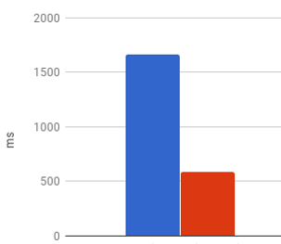
Credit-based Flow Control (Flink 1.5)
Never blocks the TCP connection
Avoids overloading of slow receivers
Improves checkpoint alignment
Checkpoint Duration
Without Flow Control
With Flow Control

Slide 46
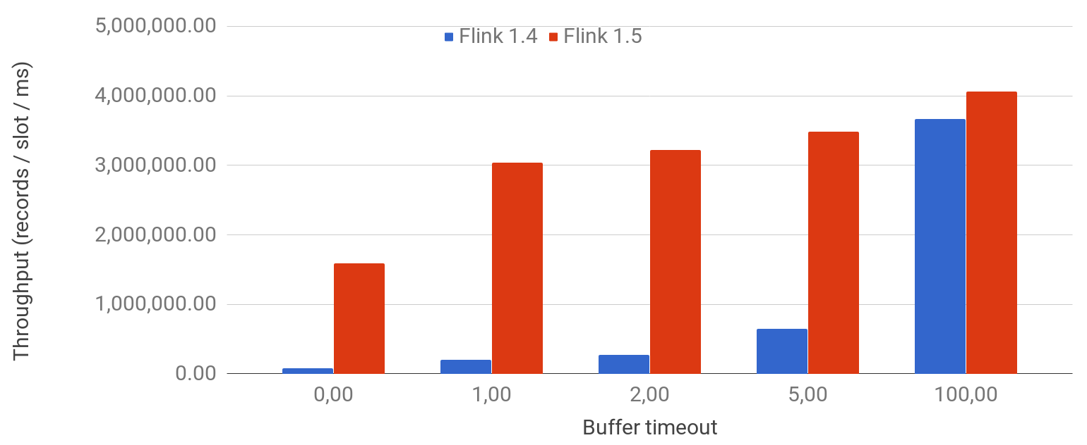
Reduced Overhead
low latency via buffer timeout
high throughput through buffers
StreamExecutionEnvironment#setBufferTimeout()
*100 nodes x 8 slots

Slide 47
Task-Local Recovery

Slide 48
Flink State and Distributed Snapshots
Take state snapshot
Stable Storage
Source
Stateful
Operation
„Asynchronous Barrier Snapshotting“

Slide 49
Flink State and Distributed Snapshots
Synchronously trigger state snapshot
(e.g. copy-on-write)
Take state snapshot
Source
Stateful
Operation

Slide 50
Flink State and Distributed Snapshots
Durably persist
full snapshots
asynchronously
Processing pipeline continues
Stable Storage
Source
Stateful
Operation

Slide 51
Recovery From Failure
Stable Storage
Source
Stateful
Operation

Slide 52
Recovery From Failure
Resume to checkpoint offset
Restore State
Stable Storage
Restore State
Source
Stateful
Operation

Slide 53
Local Recovery (Flink 1.5)
Local Snapshot
Corresponding snapshot,
but physical representation can differ
Resume to checkpoint offset
Stable Storage
Source
Local Snapshot

Slide 54
Local Recovery (TM survived)
Local Snapshot
Restore State
(local)
Resume to checkpoint offset
Stable Storage
Source
Restore State
(local)
Local Snapshot

Slide 55
Local Recovery (TM lost)
Resume to checkpoint offset
Restore State
(remote)
Stable Storage
Source
Restore State
(local)
Local Snapshot

Slide 56
SQL

Slide 57
Extended JOIN support
Support for windowed outer equi-joins
Support for non-windowed inner joins
SELECT d.rideId, d.departureTime, a.arrivalTime
FROM Departures d LEFT OUTER JOIN Arrivals a
ON d.rideId = a.rideId
AND a.arrivalTime BETWEEN
d.deptureTime AND d.departureTime + '2' HOURS
SELECT u.name, u.address, o.productId, o.amount
FROM Users u JOIN Orders o
ON u.userId = o.userId

Slide 58
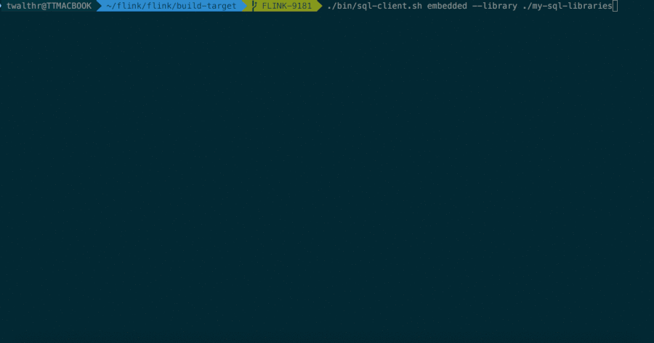
SQL Client

Slide 59
What’s next?
Flink 1.6 and beyond

Slide 60
Flink 1.6 and beyond
Java 9 (FLINK-8033) and Scala 2.12 (FLINK-7811)
Improvements for container environments,
e.g. K8s (FLINK-9495)
Full job submission through REST (FLINK-9280)
State back-ends for timers (FLINK-9485)
State back-ends for operator state

Slide 61
Flink 1.6 and beyond
BucketingSink with Flink file systems (including S3)
State evolution: support type conversion on snapshot restore
Stream SQL:
  support “update by key” Table Sources
  more table sources and sinks (Kafka, Kinesis, Files, K/V stores)
CEP
  Integrate CEP and SQL via MATCH_RECOGNIZE (FLINK-7062)
  Improve CEP performance of SharedBuffer on RocksDB
  (FLINK-9418)

Slide 62
Questions?

Slide 63

We are hiring!
data-artisans.com/careers

